Slide 1

ECG Arrhythmia Classification Using 1D CNN Leveraging the Resampling Technique and Gaussian Mixture Model Paper ID: 95 Joint 2021 5th International Conference on Imaging, Vision & Pattern Recognition (IVPR)and 10th International Conference on Informatics, Electronics & Vision (ICIEV)
Presented by
Md Remon Hasan Apu
Computer Science and Engineering
University of Asia Pacific
Dhaka, Bangladesh

Slide 2

Authors
Fahmeda Akter
Mst. Farzana Akhtar Lubna
Tanjina Helaly
Affiliation
Computer Science and Engineering
University of Asia Pacific
Dhaka, Bangladesh
Tanmoy Sarkar Pias
Affiliation
Department of Computer Science
Virginia Tech, USA
Blacksburg, USA

Slide 3
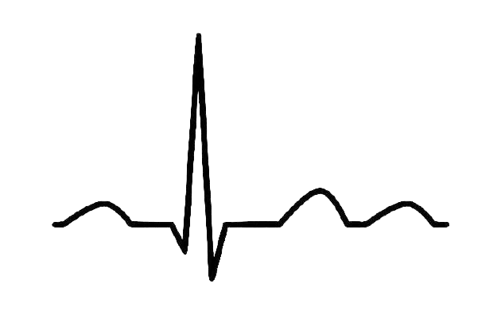
Contents
Introduction
Problems of Current System
Research Statement
ECG Arrhythmia Overview
Literature Review
Proposed Algorithm
Steps in Details
Result Analysis
Contributions
Applications
Future Plan

Slide 4
Introduction
1. What is ECG Arrhythmia Classification? ECG Arrhythmia Classification is an approach that can detect Arrhythmia which is causes heart diseases.
2. Why do we need this classification ?
A classification model that can early detect Arrhythmia will be able to reduce the death.
1

Slide 5
Problems of Current System
Existing models have require a machine with high computational power. Hence, these models are not sustainable options for the practical field.
2

Slide 6
Research Statement
ECG Arrhythmia Classification Using 1D CNN Leveraging the Resampling Technique and Gaussian Mixture Model
3

Slide 7
ECG Arrhythmia Overview
1. What is ECG ? ECG is the graphical representation of electrical activity which is generated by the cells of the heart.
2. What is Arrhythmia ?
Arrhythmia is abnormal rhythm or irregularity of the heartbeat..
4

Slide 8
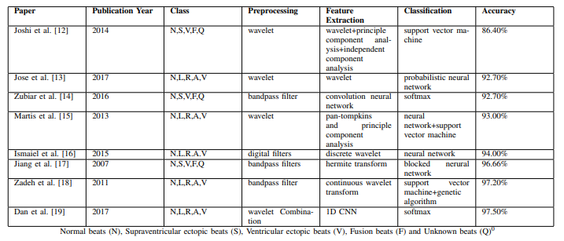
Literature Review
5

Slide 9
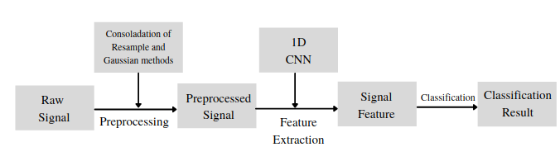
Proposed Technique
6

Slide 10
Dataset Overview
MIT-BIH Arrhythmia Dataset
Grouped the heartbeats data samples into major five classes we used the AAMI:
Dataset | Total Samples | Training data | Testing Data
MIT-BIH Arrhythmia | 1,09,446 | 80% | 20%
N | S | V | F | Q
Normal beats | Supraventricular ectopic beats | Ventricular ectopic beats | Fusion beats | Unknown beats
7

Slide 11
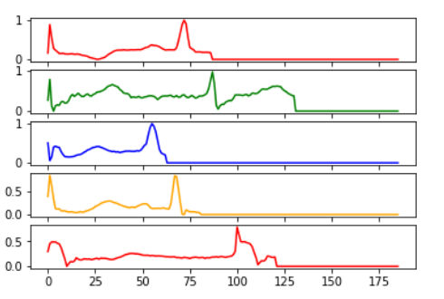
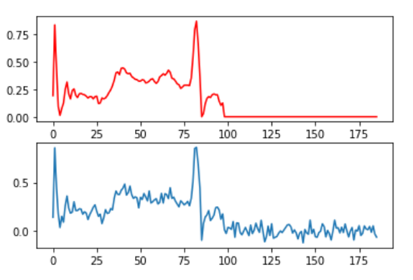
ECG Arrhythmia Classification Steps
Preprocessing
Resample
Gaussian Mixture
1D CNN
8

Slide 12
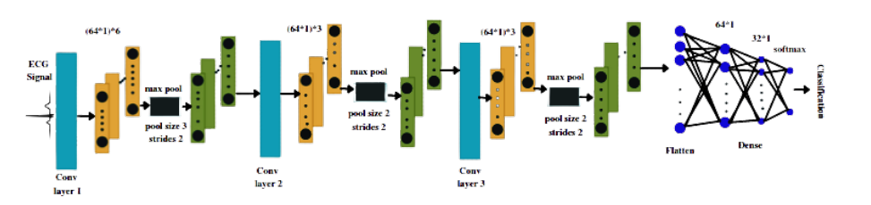
ECG Arrhythmia Classification Steps
1D CNN ( Convolutional Neural Network)
9

Slide 13
ECG Arrhythmia Classification Steps
Resample
Resample technique is chosen more than the class weights include 20,000 samples of each classes.
10

Slide 14
ECG Arrhythmia Classification Steps
Gaussian Mixture
Gaussian Mixture stands for getting the R wave peak of ECG where it is fallen.
11

Slide 15
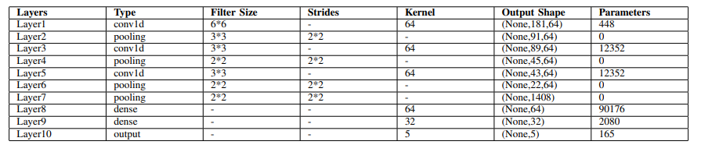
ECG Arrhythmia Classification Steps
Lightweight 1D CNN Parameters
1D CNN
12

Slide 16
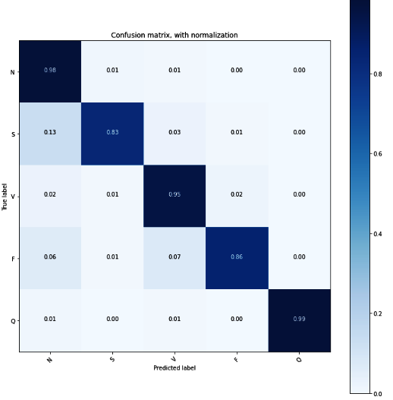
ECG Arrhythmia Classification Steps
Confusion Matrix
12

Slide 17
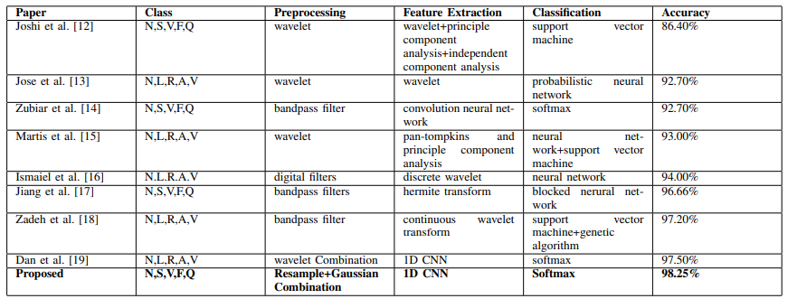
Result Analysis
Table: Accuracy Chart
Classification Model | Total Samples | Training data | Testing Data | Accuracy
1D CNN | 1,09,446 | 80% | 20% | 98.25%
Table: Comparison with existing models
13

Slide 18
Our Contributions
A combination of resampling and the Gaussian method is used. Accordingly, it contains the simple method of an algorithmic model for preprocessing.
Relatively faster than existing systems.
We achieved state-of-the-art performance in the arrhythmia classification of ECG by using a computationally light 1D convolution neural network.
14

Slide 19
Future Work
The two-dimension peak of a signal can be used for arrhythmia classification into more classes.
a pre-notification system can be developed to notify arrhythmias probability.
15

Slide 20
Application
Detect the Arrhythmia as early to reduce the probabilities of death.
Using the proposed light model where the high ended devices are not be effortable for Arrhythmia Classification.
16

Slide 21
References
[1] P. -Y. Hsu and C. -K. Cheng, ”Arrhythmia Classification using Deep Learning and Machine Learning with Features Extracted from Waveform-based Signal Processing”, 2020 42nd Annual International Conference of the IEEE Engineering in Medicine Biology Society (EMBC), Montreal, QC, Canada, 2020, pp. 292-295.
[2] M. Shahin, E. Oo and B. Ahmed, ”Adversarial Multi-Task Learning for Robust End-to-End ECG-based Heartbeat Classification”, 2020 42nd Annual International Conference of the IEEE Engineering in Medicine Biology Society (EMBC), Montreal, QC, Canada, 2020, pp. 341-344.
[3] X. Xu and H. Liu, ”ECG Heartbeat Classification Using Convolutional Neural Networks”, in IEEE Access, vol. 8, pp. 8614-8619, 2020.
[4] Nurmaini, Siti; Darmawahyuni, Annisa; Sakti Mukti, et al. 2020. ”Deep Learning-Based Stacked Denoising and Autoencoder for ECG Heartbeat Classification”, Electronics 9, no. 1: 135.
[5] Hong S, You T, Kwak S, et al. ”Online Tracking by Learning Discriminative Saliency Map with Convolutional Neural Network[J]”. Computer ence, 2015:597-606.A
[6] Shen, Yelong, Xiaodong, Gao, Jianfeng, et al. ”Learning Semantic Representations using Convolutional Neural Network for Web Search[J]”, proc www, 2014:373-374.A
[7] Kiranyaz S, Ince T, Hamila R, Gabbouj M. ”Convolutional Neural Networks for patient-specific ECG classification”, Annu Int Conf IEEE Eng Med Biol Soc. 2015;2015:2608-11.
[8] Dosovitskiy A, Springenberg J T, Brox T. ”Learning to Generate Chairs with Convolutional Neural Networks[C]”, 2015 IEEE Conference on Computer Vision and Pattern Recognition (CVPR). IEEE, 2015.
17

Slide 22
References
[9] N. P. Joshi, P. S. Topannavar, ”Support vector machine based heartbeat classification”, In Proc. of 4th IRF Int. Conf , pp. 140-144. 2014.
[10] J. A. Gutierrez-Gnecchi, R. Morfin-Maga ´ na, D. Lorias-Espinoza, et al. ˜ ”DSP-based arrhythmia classification using wavelet transform and probabilistic neural network”, Biomedical Signal Processing and Control, vol. 32, pp. 44-56, 2017.
[11] M. Zubair, J. Kim, and C. Yoon. ”An Automated ECG Beat Classification System Using Convolutional Neural Networks”, In IT Convergence and Security (ICITCS), 2016 6th International Conference on , pp. 1-5. 2016. IEEE
[12] R. J. Martis, U. R. Acharya, K. M. Mandana, et al, ”Cardiac decision making using higher order spectra”, Biomedical Signal Processing and Control, vol. 8, no. 2, pp.193-203, 2013.
[13] smaiel, Fatima Osman Mohamed. ”Classification of Cardiac Arrhythmias Based on Wavelet Transform and Neural Networks”, Sudan University of Science Technology. 2015. IEEE
[14] W. Jiang and S. G. Kong, ”Block-based neural networks for personalized ECG signal classification”, IEEE Transactions on Neural Networks, vol. 18, no. 6, pp. 1750–1761, 2007. IEEE
[15] Zadeh A E, Khazaee A. ”High Efficient System for Automatic Classification of the Electrocardiogram Beats”, Annals of Biomedical Engineering, vol. 39, no. 3, pp. 996-1011. 2011. IEEE
[16] D. Li, J. Zhang, Q. Zhang and X. Wei, ”Classification of ECG signals based on 1D convolution neural network”, 2017 IEEE 19th International Conference on e-Health Networking, Applications and Services (Healthcom), Dalian, 2017, pp. 1-6.
18

Slide 23
Thank You Github Link: https://github.com/Remonhasan/ecg-arrhythmia-classification-using-1d-cnn

